Slide 1
#CAMHScampfire No.3
Developmental Language Disorder and reoffending
Evidence from a prospective cohort study
of first-time offenders

Slide 2
Hello!
Andre Tomlin (Chair, The Mental Elf)
Richard Church (Professor and clinical psychologist)
Maxine Winstanley (Lead researcher)
Douglas Badenoch (Information specialist, Minervation)
Celine Ryckaert (Psychiatrist and researcher, ACAMH)
Please use the poll to tell us about yourselves!

Slide 3
Agenda
Introductions
What is the research question?
Is this evidence valid?
What are the findings?
Is this valid, important evidence helpful?
Closing remarks
Please use the chat window to post any questions you have.

Slide 4
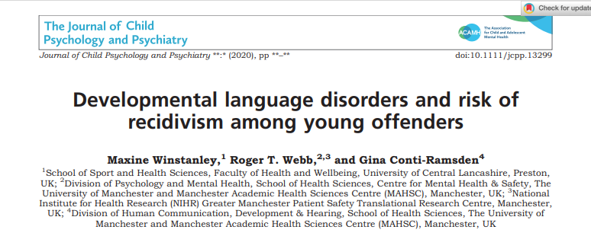
The research question?
“In first-time offenders, what is the prevalence of DLD, and is the presence of DLD associated with the risk of reoffending?”

Slide 5
Study methods
Participants were recruited from youth offending services in NW England.
Aimed for first offenders
Language ability was evaluated using subtests of the CELF-4 assessment. The cut-off for DLD was >1.5 SDs below the normative mean.
Also measured nonverbal IQ, adversity, prior offending, deprivation and CU traits
Followed for 1 year

Slide 6
Critical appraisal
Question | Yes | Can’t tell | No
1. Did the study address a clearly focused issue? | X
2. Was the cohort recruited in an acceptable way? | X
3. Was the exposure accurately measured to minimise bias? |  | X
4. Was the outcome accurately measured to minimise bias? | X
5. (a) Have the authors identified all important confounding factors? |  | X
5. (b) Have they taken account of the confounding factors in the design and/or analysis? | Y
6. (a) Was the follow up of subjects complete enough? | X
6. (b) Was the follow up of subjects long enough? | X
7. What are the results of this study?
8. How precise are the results?
9. Do you believe the results? | X
10. Can the results be applied to the local population? |  | X
11. Do the results of this study fit with other available evidence? | X
12. What are the implications of this study for practice?

Slide 7
Critical appraisal
Limits of observational design re confounders
Efforts were made to investigate known confounders
Potential for selection bias
Not clear why some people did not want to participate
Potential for ascertainment bias re: DLD
was checked by a separate SLT researcher
Sample size is quite small
Broadly consistent with other evidence

Slide 8
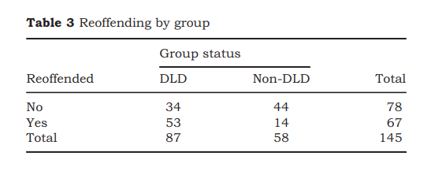
Study findings
145 young offenders took part:
60% had DLD
Of them, 62% reoffended compared with 25% of non-DLD
The Hazard Ratio for reoffending in DLD participants compared with non-DLD was 2.61 (95% CI 1.8-3.78).

Slide 9
Implications
Consider:
Replicating this study in different, larger and/or more complete cohorts
Adapting interventions to take account of the high prevalence of DLD
Involving speech and language therapists (SLTs) in multidisciplinary youth justice teams
Running evaluation studies of these interventions.

